Slide 1
YESHIVA UNIVERSITY · COMPUTER SCIENCE
When Semantic Alignment Helps Sequential Recommendation
Bridging language-model semantics and sequential recommendation through contrastive alignment
Two small MLP heads on top of vanilla SASRec, trained with InfoNCE against a frozen sentence encoder, lift NDCG@10 by +60% on sparse, text-rich data.
David Wexler
3 datasets · 5 seeds · 14 ablation variants
dwexler1@mail.yu.edu
github.com/DavWexler/When-Semantic-Alignment-Helps-Sequential-Recommentation

Slide 2
THE SETUP
Two recent ideas pull in opposite directions.
One understands order. The other understands meaning. Neither does both.
SASRec · Kang & McAuley, 2018
RLMRec · Ren et al., WWW 2024
Sequential recommenders
LLM-aligned recommenders
Causal self-attention over a user's ordered history of item IDs.
Contrastively align user/item embeddings with frozen sentence-transformer text.
+
Captures temporal dynamics — what you watch next.
+
Embeddings reflect topical meaning, not just co-occurrence.
−
Every item is an opaque integer. Title, genre, description: invisible.
−
Only ever tested on graph CF backbones — no notion of sequence.
SemanticSASRec
02 / 25

Slide 3
THE QUESTION
Can one model understand order and meaning at the same time?
The published RLMRec paper benchmarks six graph-CF backbones — GCCF, LightGCN, SGL, SimGCL, DCCF, AutoCF. Every one ignores interaction order by design. Whether the same auxiliary alignment helps a sequential transformer was left open.
The gap
03 / 25

Slide 4
CONTRIBUTIONS
Three concrete contributions.
01
02
03
A drop-in extension of SASRec
A fair three-way head-to-head
A 14-variant ablation grid
Each row flips one knob: loss components, λ sweep, τ sweep, projection-head architecture, sentence encoder. Paired t-tests against an in-ablation reference at held-constant seeds and epoch budget.
Two two-layer MLP projection heads map SASRec's 50-d state into BGE-large's 1024-d semantic space. Trained with symmetric InfoNCE against frozen profile embeddings. Backbone, prediction head and BCE loss are all standard.
SASRec, RLMRec+LightGCN, and SemanticSASRec on three datasets that span the density spectrum. Same splits, same evaluator, same five seeds for every (model, dataset) cell. Full-rank leave-one-out — no sampled negatives.
Contributions
04 / 25

Slide 5
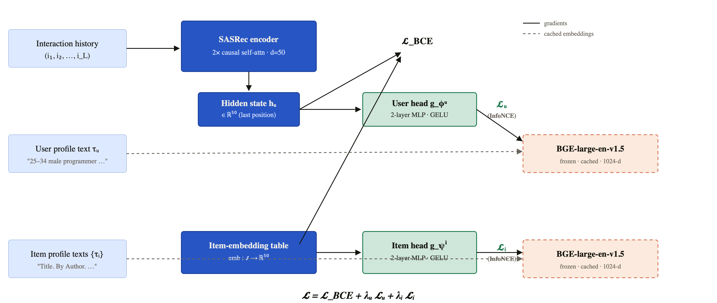
METHOD · ARCHITECTURE
Two projection heads, one frozen text encoder.
Architecture (Figure 1)
05 / 25

Slide 6
METHOD · LOSS
The training objective is one weighted sum.
𝓛 = 𝓛_{BCE} + λ_{u} 𝓛_{u} + λ_{i} 𝓛_{i}
𝓛_BCE
𝓛_u · symmetric InfoNCE
𝓛_i · symmetric InfoNCE
Sequential CF loss
User alignment
Item alignment
Masked BCE on SASRec hidden states against positives and sampled negatives.
Pulls g_φᵘ(hᵤ) toward f_enc(τᵤ). In-batch negatives.
Pulls g_ψⁱ(emb(i)) toward f_enc(τᵢ). Unique positives in batch, sub-sampled to K=512.
Defaults (RLMRec paper): λ_{u} = λ_{i} = 0.1 · τ = 0.1
Training objective
06 / 25

Slide 7
EXPERIMENTAL SETUP
Three datasets span the density spectrum.
Same splits, same five seeds, same full-rank leave-one-out evaluator for every cell.
DATASET
USERS
ITEMS
~ INTER. / USER
ITEM TEXT
DENSITY
MovieLens-1M
6,040
3,706
~165
Title + 1–3 genres
dense
Harper & Konstan, 2015
Yelp Open Dataset
104,072
54,056
~10
Name + categories + city + stars
sparse
2018-01-01 onward, 5-core
Amazon-Books (2023)
156,213
112,362
~6
Title + author + 4-level cat + 400-char description
very sparse · rich text
Hou et al., 2024 · 5-core
ML-1M tests whether the recipe breaks where SASRec is already near-optimal. Yelp and Amazon-Books are the natural transfer test — they sit in the regime RLMRec was originally designed for.
Datasets
07 / 25

Slide 8
HEADLINE RESULT · RELATIVE NDCG@10 VS. VANILLA SASREC
The lift tracks data sparsity and item-text richness.
AMAZON-BOOKS
YELP
MOVIELENS-1M
very sparse · rich text
sparse · medium text
dense · short text
+60.0%
+30.8%
−3.3%
NDCG@10: 0.0222 → 0.0355 HR@10: +50.6% · MRR: +53.2%
NDCG@10: 0.0125 → 0.0164 HR@10: +28.7% · MRR: +24.4%
NDCG@10: 0.1126 → 0.1089 Within 1.5σ. Approximately neutral.
worst SemanticSASRec-seed (0.0348) > best SASRec-seed (0.0230)
RLMRec+LightGCN also beats SASRec — alignment alone helps.
Item text = title + 1–3 genres. No semantic room to add value.
Headline · full-rank LOO, 5 seeds
08 / 25

Slide 9
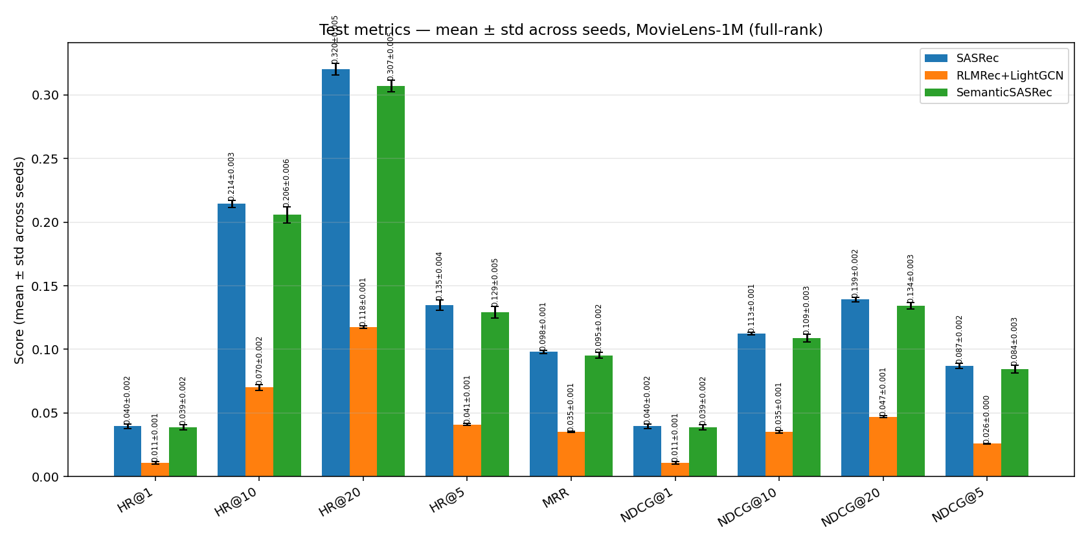
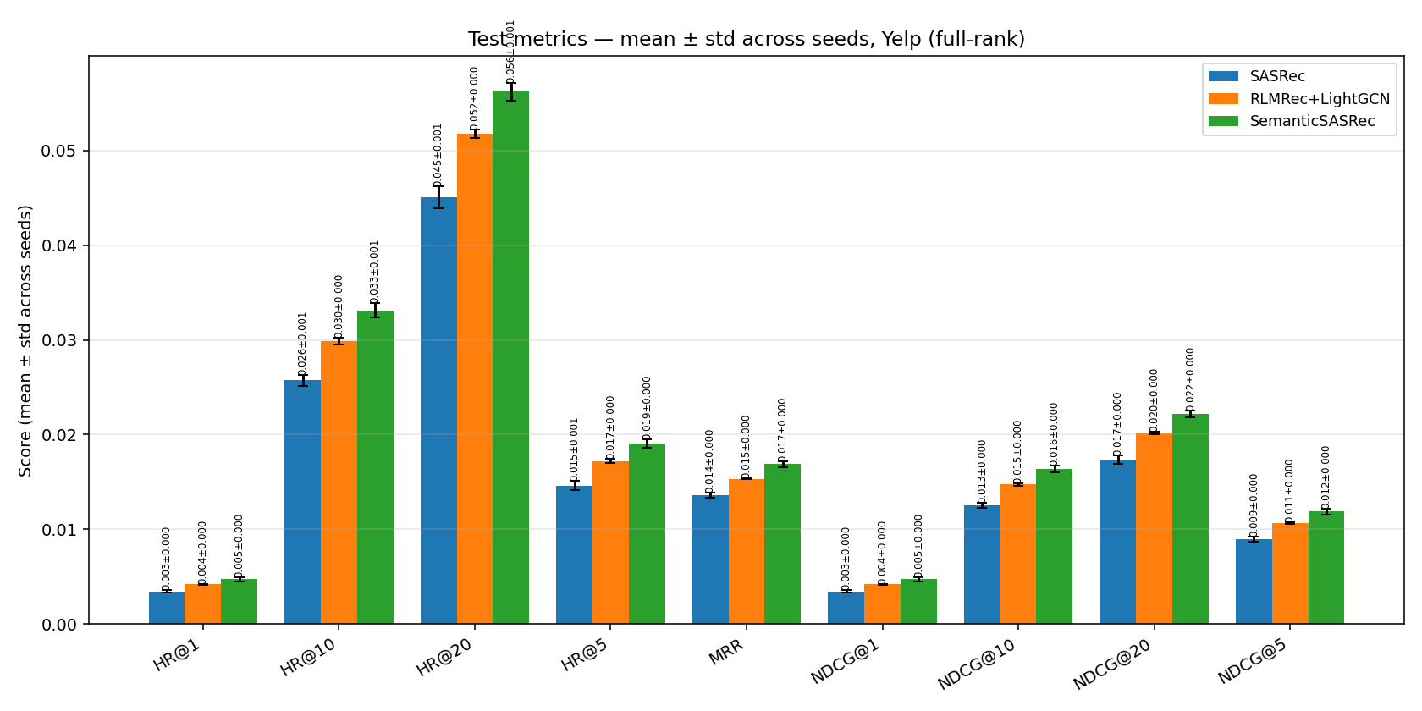
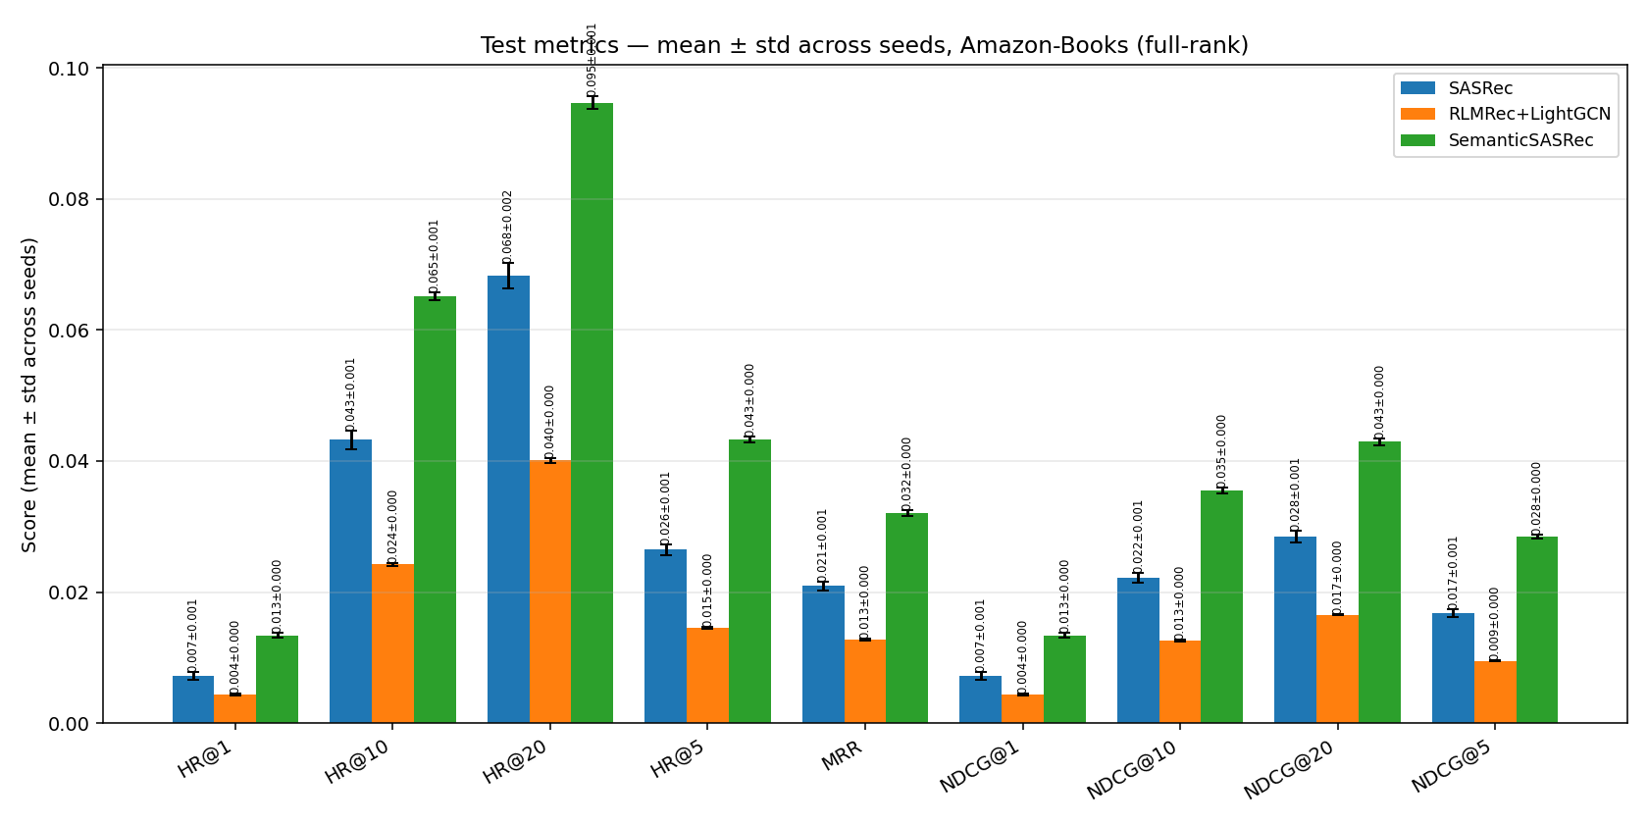
HEADLINE RESULT · TEST METRICS
All nine metrics agree on the ordering.
SASRec
RLMRec+LightGCN
SemanticSASRec (ours)
MovieLens-1M
Yelp
Amazon-Books
Amazon-Books: green dominates by a wide margin. · Yelp: green wins everywhere; orange also beats blue. · ML-1M: blue and green track; orange trails (LightGCN has no temporal signal).
Test metrics
09 / 25

Slide 10
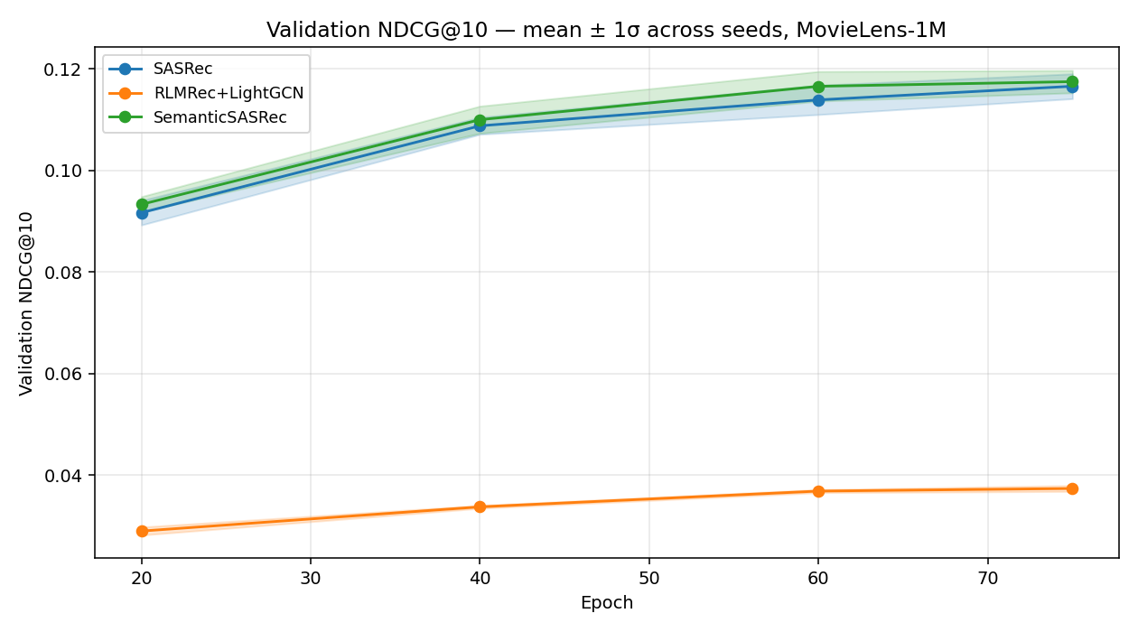
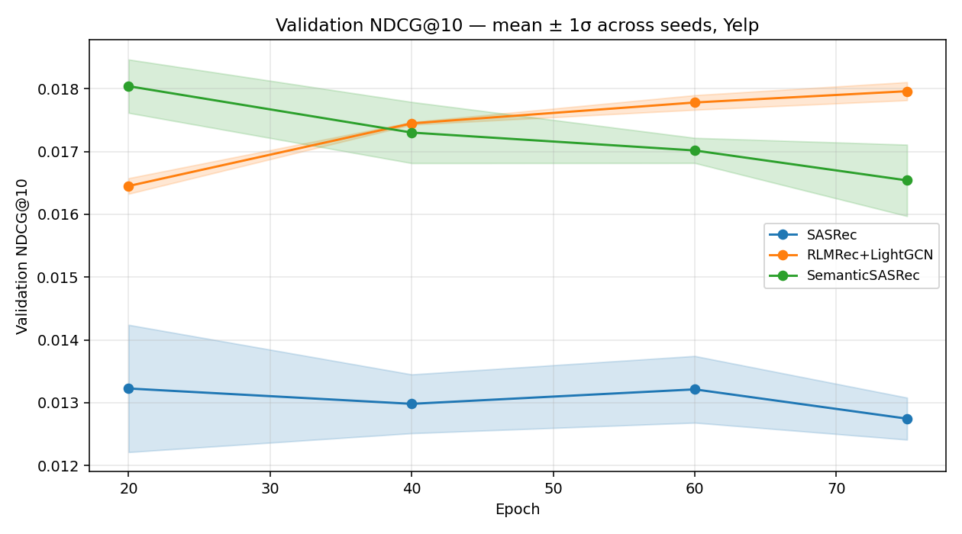
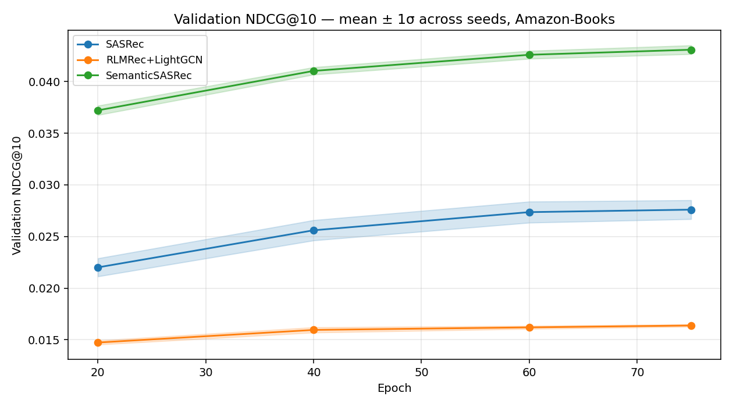
HEADLINE RESULT · VALIDATION NDCG@10 VS. EPOCH
The gap on text-rich data opens within 20 epochs.
MovieLens-1M · two curves within 1σ
Yelp · gap widens through training
Amazon-Books · separation by epoch 20
Validation curves · mean ± 1σ over 5 seeds
10 / 25

Slide 11
ABLATION · FIVE PATTERNS
Which design choices actually matter?
01 · Loss components
02 · λ sweep
Both alignment heads matter on sparse data, asymmetrically . Amazon-Books: user head dominates (−32% NDCG to remove). Yelp: item head dominates (−16%).
Bell-shaped on every dataset. Default λ = 0.1 sits near the peak. λ = 1.0 collapses by 19–39%.
03 · InfoNCE temperature
04 · Projection head
The most robust knob. Entire τ sweep stays within ±10% on every dataset.
Linear matches MLP on dense / short-text data. MLP wins by 18.6% on Amazon-Books — the nonlinearity decouples CF ranking from semantic alignment.
05 · Sentence encoder
Swapping BGE-large (1024-d) for MiniLM (384-d) costs 20% NDCG on Amazon-Books, ≤7% elsewhere. When the text is rich, encoder capacity matters; when it isn't, none of these knobs save you.
Ablation summary
11 / 25

Slide 12
LIMITATIONS
Three caveats on the claim.
01
02
03
Template profiles, not LLM-authored
Backbone untuned per dataset
Single-step next-item only
Evaluation is leave-one-out next-item — the protocol both SASRec and RLMRec target. Session-level or multi-step retrieval may behave differently.
RLMRec originally used an LLM to write user/item profiles; I used a deterministic template builder. Reported gains are almost certainly a lower bound.
A higher dropout or longer max sequence is known to help on Amazon-Books. Defaults kept across all three datasets to keep the comparison clean.
Limitations
12 / 25

Slide 13
CONCLUSION
RLMRec-style alignment transfers cleanly to a sequential backbone — in the data regime it was designed for.
+60%
2 MLPs
~0 ms
NDCG@10 on Amazon-Books
total engineering footprint on top of SASRec
added wall-clock at training (cache + tiny logit matrices)
Full code, configs, seeds, and the cached semantic embeddings are released. python run_everything.py reproduces Table 1 end to end.
Questions?
End of core talk
13 / 25

Slide 14
— OPTIONAL —
§ appendix
Deep dive
Profile construction · backbone in detail · InfoNCE derivation · projection-head design · Algorithm 1 · full ablation table · comparison to original papers.
Deep-dive section
14 / 25

Slide 15
DEEP DIVE · DATASETS IN DETAIL
Density and text richness pull in opposite directions.
MovieLens-1M
Yelp Open Dataset
Amazon-Books 2023
Harper & Konstan 2015 · ratings ≥2000
2022 release · reviews ≥ 2018-01-01 · 5-core
Hou et al. 2024 · 5-core · ≥ 2018-01-01
users
6,040
users
104,072
users
156,213
items
3,706
items
54,056
items
112,362
~ inter/user
~165
~ inter/user
~10
~ inter/user
~6
item text
title + genres
item text
name + categories + city + stars
item text
title + author + 4-level cat + 400-char desc
user text
demo + top-3 genres + last 5 films
user text
review_count + top-3 cats + last 5 places
user text
total reviews + top-3 cats + last 5 titles
"The Pragmatic Programmer. By Hunt & Thomas. Categories: Computers › Software… …4.5 average stars."
"Star Wars (1977). Genres: Action, Adventure, Sci-Fi."
"Joe's Pizza. Categories: Italian, Pizza. Located in NYC, NY. 4.0 stars."
Dataset detail
15 / 25

Slide 16
DEEP DIVE · PROFILE TEXT
Profiles are templated, not LLM-authored.
Each profile is a single short string built deterministically from structured metadata.
ITEM PROFILE · ML-1M
ITEM PROFILE · Amazon-Books
Star Wars (1977). Genres: Action, Adventure, Sci-Fi.
The Pragmatic Programmer. By Hunt & Thomas. Categories: Computers › Software › Methodology. Author: Andrew Hunt, David Thomas. A guide for working programmers… 4.5 average stars.
USER PROFILE · ML-1M
A 25–34 male programmer who enjoys Action, Sci-Fi, Adventure movies. Recently watched: Inception; The Matrix; Star Wars; …
USER PROFILE · Amazon-Books
82 reviews across Computers, Fantasy, Biography. Recently read: Designing Data-Intensive Apps; The Hobbit; Algorithms; …
Short, structured. Little to align with beyond IDs.
Paragraph-scale. The richness is exactly what the alignment latches onto.
Profile construction
16 / 25

Slide 17
DEEP DIVE · BACKBONE
SASRec backbone — paper-faithful, unchanged.
Embedding
Hyperparameters (held constant across datasets)
E⁽⁰⁾_{t} = √d · emb(i_{t}) + pos(t)
hidden dim d
50
attn. blocks N
2
Masked BCE loss
attention heads
1
𝓛_{BCE} = − (1/|M|) Σ_{(u,t)∈M} log σ(H_{u,t}⊤ emb(i_{t}⁺)) + log(1 − σ(H_{u,t}⊤ emb(i_{t}⁻)))
dropout
0.2
batch size
128
One sampled negative per position. At inference, only the last-position state is scored against every item, with training + validation items masked to −∞.
max seq. length
200
optimizer
Adam · lr 1e-3
β₁, β₂
0.9, 0.98
Sequences left-padded to 200 with ID 0. Pre-norm causal multi-head attention with point-wise feed-forward (two 1×1 convs + residual). Final LayerNorm before scoring.
SASRec backbone
17 / 25

Slide 18
DEEP DIVE · ALIGNMENT LOSS
Symmetric InfoNCE on L2-normalized projections.
Let q = g_{θ}(x) be the projected CF vector and k be the L2-normalized frozen semantic target. Form the cosine-similarity logit matrix
User head (𝓛_u)
Anchor = batch's projected last-position states g_φᵘ(h_{u}) . Target = cached f_{enc}(τ_{u}). In-batch negatives = other users in the batch.
M_{ij} = (q̂_{i}⊤ k̂_{j}) / τ
Minimize the average of two cross-entropies on this matrix:
𝓛_{InfoNCE} = ½ [ CE(M, I) + CE(M⊤, I) ]
Item head (𝓛_i)
Matched pairs sit on the diagonal. Averaging the two views — "for each query, which key matches?" and "for each key, which query matches?" — keeps the gradient symmetric. The variant used in the RLMRec paper.
Anchor = unique positives in the batch, sub-sampled to K=512. Same emb-row used by BCE — no separate aligned-only copy.
defaults
τ = 0.1 · K = 512
sweep: τ ∈ {0.05, 0.2, 0.5}
InfoNCE detail
18 / 25

Slide 19
DEEP DIVE · PROJECTION HEADS
Two-layer MLP. The nonlinearity is the design choice.
g_{θ}(x) = W₂ · GELU( W₁ x + b₁ ) + b₂
Why nonlinear, not linear?
Following the SimCLR result [Chen et al. 2020] : a nonlinear head decouples the underlying representation from the contrastive objective.
W₁
∈ ℝ^{1024 × 50}
W₂
∈ ℝ^{1024 × 1024}
hidden width h
max(d, D) = 1024
The CF embedding is free to preserve ranking-relevant information that does not perfectly align with the semantic target. A linear projection cannot make that decoupling.
CF dim d
50 (= SASRec width)
semantic dim D
1024 (= BGE-large)
Ablation: linear costs −18.6% NDCG on Amazon-Books (p < 0.01); neutral on Yelp / ML-1M. The decoupling only earns its keep when there is rich text to absorb.
Item head reuses the same emb -row that the BCE head scores against. The shared row must satisfy both objectives — that sharing is the whole point.
Projection heads
19 / 25

Slide 20
DEEP DIVE · ALGORITHM 1
One training epoch of SemanticSASRec
01: Shuffle user index π
02: for b ∈ {0, batch_size, 2·batch_size, …} do
03: Gather B = π[b : b + batch_size] users
04: Build (S, P, N) — input seqs, positives, sampled negatives
05: H ← SASRec.encode(S) # (|B|, L, d)
06: 𝓛_{BCE} ← Eq. 3 from H, P, N
07: Q_{u} ← g_{φ}^{u}(H_{:,L−1,:})
08: 𝓛_{u} ← InfoNCE(Q _{u}, E_{u}[B], τ)
09: I ← unique non-padding items in P, sub-sampled to K = 512
10: Q_{i} ← g_{ψ}^{i}(emb(I))
11: 𝓛_{i} ← InfoNCE(Q_{i}, E_{i}[I], τ)
12: 𝓛 ← 𝓛_{BCE} + λ_{u}·𝓛_{u} + λ_{i}·𝓛_{i}
13: Adam step on ∇𝓛
14: end for
Both InfoNCE logit matrices are tiny relative to the attention block: |B|×|B| = 128×128 for the user head; K×K ≤ 512×512 for the item head. Alignment adds essentially no wall-clock overhead.
Algorithm 1
20 / 25

Slide 21
DEEP DIVE · ABLATION TABLE
Full ablation grid · NDCG@10 vs. sasrec_full
VARIANT
ML-1M Δ%
YELP Δ%
AMAZON Δ%
LOSS COMPONENTS
no user-align (λᵤ = 0)
−11.2 *
+2.1
−32.0 **
no item-align (λᵢ = 0)
+4.5
−15.7 *
−8.7 *
no align (~ pure SASRec)
+4.1
−25.3 **
−38.8 **
ALIGNMENT WEIGHT Λ SWEEP
λ = 0.01
+6.1
−8.9 **
−19.5 **
λ = 0.05
+6.4 *
+1.7
−1.5
λ = 0.5
−28.4 **
−16.0 **
−11.0 *
λ = 1.0
−38.7 ***
−26.0 ***
−19.0 **
INFONCE TEMPERATURE Τ · ARCHITECTURE / ENCODER
τ = 0.05
−2.9
−7.0
−6.6 **
τ = 0.2
+3.4
+3.1
−0.6
τ = 0.5
+6.3
−3.8
−9.5 *
linear proj-head
−2.6
−1.2
−18.6 **
MiniLM-L6-v2 encoder
−6.9
−3.3
−20.1 **
3 seeds × 50 epochs per cell. Paired two-sided t-tests vs. sasrec_full: * p<.05 ** p<.01 *** p<.001.
Ablation table (Table 2)
21 / 25

Slide 22
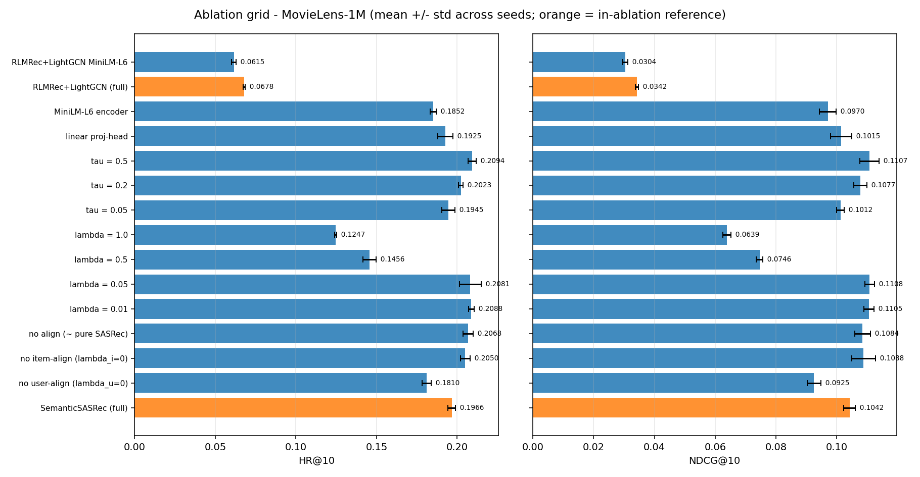
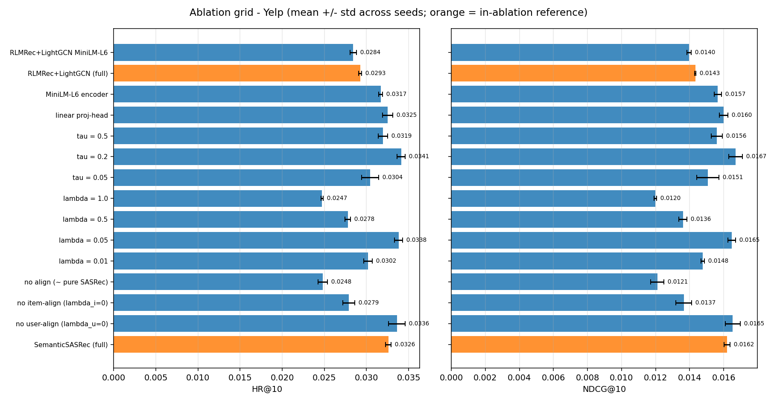
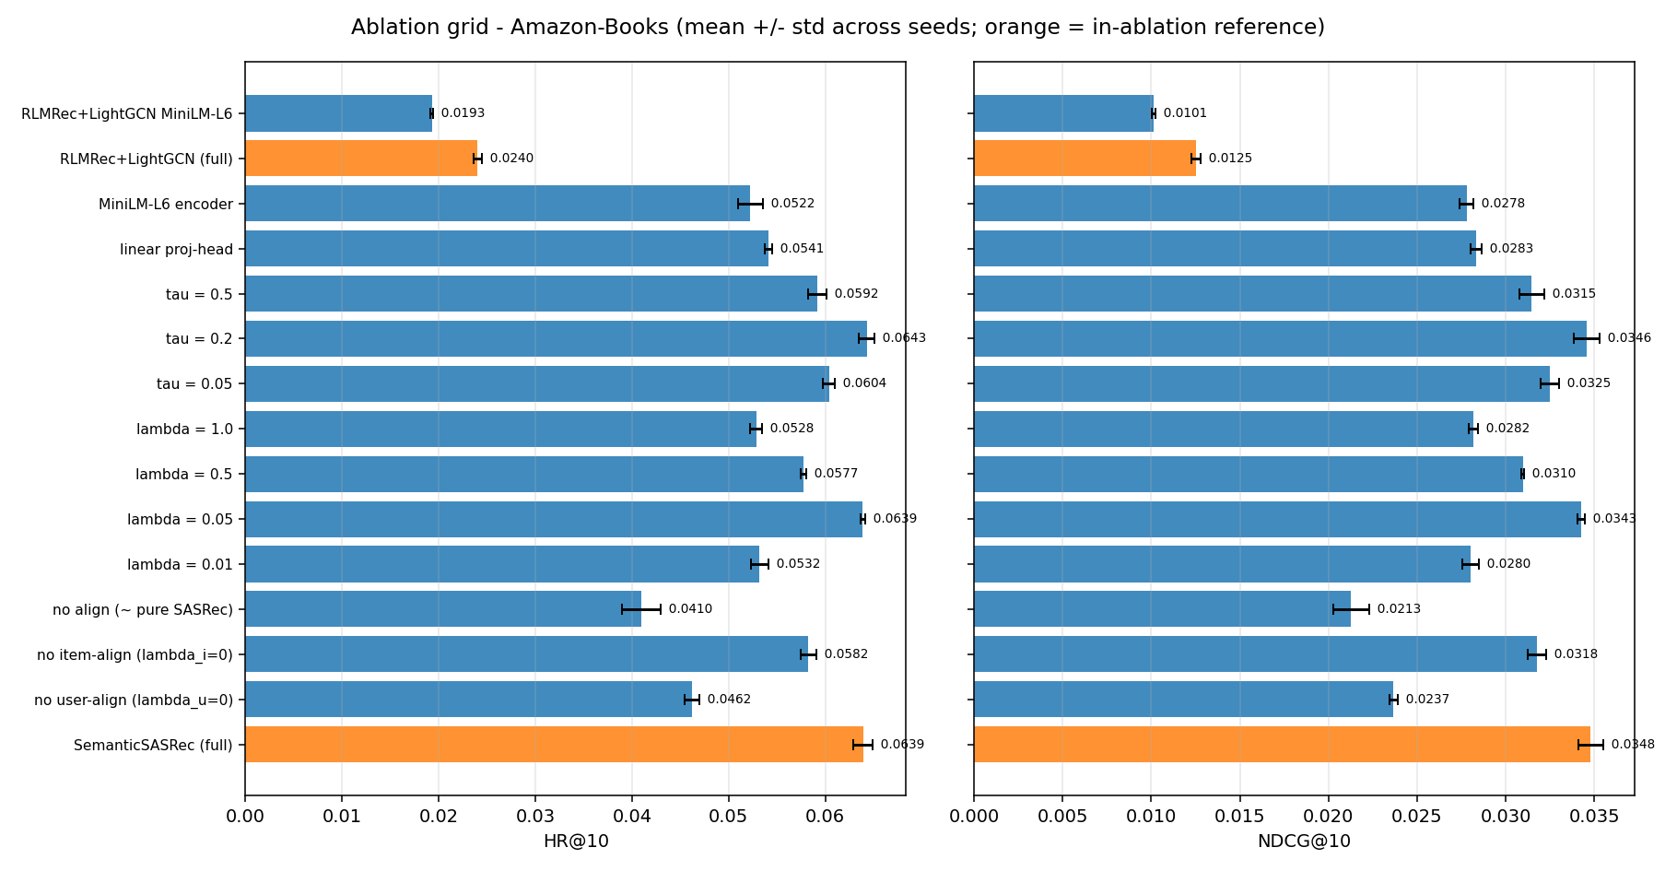
DEEP DIVE · ABLATION VISUALIZATION
HR@10 & NDCG@10 per variant · orange = sasrec_full reference.
MovieLens-1M
Yelp
Amazon-Books
ML-1M: ref. sits mid-cluster — alignment adds nothing here. · Yelp: ref. dominates — item head removal is the most costly single ablation. · Amazon-Books: ref. clearly best — both heads, the MLP, and the encoder all matter.
Ablation bars
22 / 25

Slide 23
DEEP DIVE · FUTURE WORK
Four natural extensions.
01
02
LLM-authored profiles
Generative alignment (RLMRec-Gen)
Replace the deterministic template with a Claude / GPT-4 profile builder. Expected: Yelp and Amazon-Books gains grow further; ML-1M could plausibly flip positive once a movie's profile is a paragraph instead of three words.
The contrastive head is the simpler of the two objectives in the original paper. Test whether the masked-autoencoder variant carries similarly large gains on the sequential side.
03
04
Multi-encoder consensus
Cold-start via head inversion
Two frozen encoders (e.g. one small + one large, or English + multilingual) contributing separate alignment heads — trading encoder dimension against representational diversity.
An unseen item has no learned ID embedding, but it does have a semantic embedding. The item-projection head could in principle be inverted to bootstrap a synthetic CF embedding for new items at inference time.
Future work
24 / 25

Slide 24
THANK YOU
Questions?
25 / 25

